Slide 1
Key Topic
The FRAME Routine
Banking Options
is about…
Investigating the different forms of paying for goods and services other than cash
Checks
Debit Card
Credit Card
Payday Loan
Not a loan, used as
a form of payment.
money is taken from
a checking account
Not a loan, use as a form
of payment. Money is
taken from a checking
account
Is a LOAN, used as a form
of payment. Money is
paid by the credit card
company and must be
paid by with interest.
Is a LOAN, used as a form
Of payment. Money is
given to borrower and
must be paid by with
interest.
Purchases are paid in full
Purchases are paid in full
Purchases can be paid
Back over time in smaller
Monthly payments along
With the interest.
The loan and the interest
Must be paid back ALL AT
ONCE after a short period
Of time.
Used for daily expenses;
such food, bills, etc.
Used for daily expenses;
such food, bills, etc.
Used for emergency
expenses and sometimes
large purchases.
Used for emergency
expenses but are not a
financially responsible
option
Gives you a record of
the purchase through
your bank
Gives you a record of the
purchase through your
bank
Protects you against
fraudulent charges, gives
you a record through
the credit card company
Does not offer any
benefit of record keeping
So What? (What’s important to understand about this?)

Slide 2
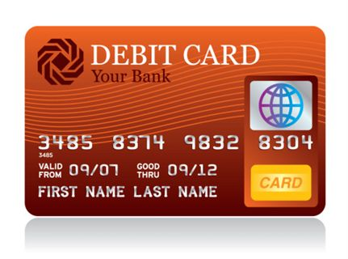
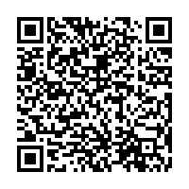
Practice:
2.
Debit Card:
1.
Checks:
3.
4.
Credit Card: Paul wants to buy the latest basketball shoes but does not have $200 to buy them. He buys the shoes using his credit card which has a compound interest rate of 23%. If Paul takes a year to pay off his credit card how much interest will he pay on the shoes?
Payday Loan: Justin’s car broke down. The repair costs are $500. Because he does not have any money
saved, he will have to get a “payday loan” for the car repair. He researched 7-day payday loans and found that he will owe $7.50 for every $100 he borrows, plus the money he borrows. How much will Frankie have to pay back, if he takes the 7-day payday loan?
You can also use a credit card calculator

Slide 3
The FRAME Routine
Key Topic
is about…
So What? (What’s important to understand about this?)

